Slide 1
K means clustering
Bhuvaneshwari Patil

Slide 2
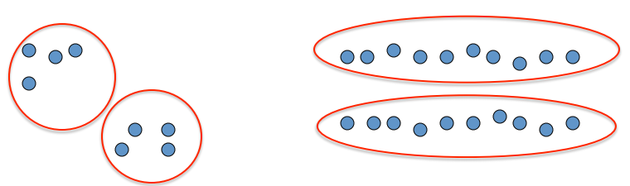
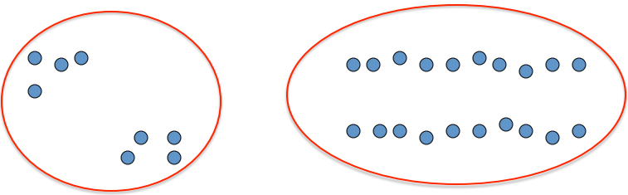
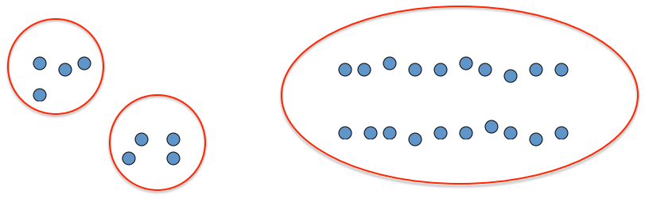
clustering

Slide 3
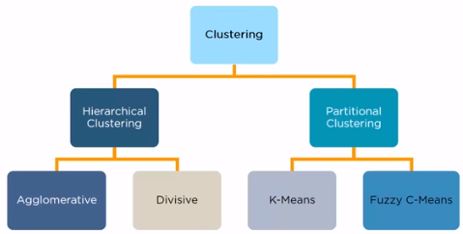
Clustering & types
– Unsupervised learning
– Requires data, but no labels
– Detect patterns e.g. in
• Group emails or search results
• Customer shopping patterns
• Regions of images
– Useful when don’t know what you’re looking for
– But: can get gibberish

Slide 4
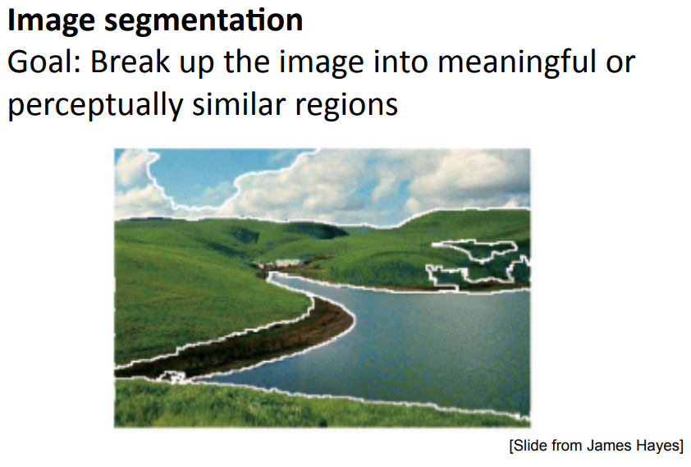
Clustering example
What could “similar” mean?
– One option: small Euclidean distance (squared)
– Clustering results are crucially dependent on the measure of similarity (or distance) between “points” to be clustered

Slide 5

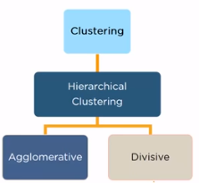
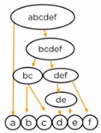
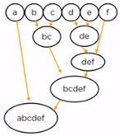


Hierarchical Clustering
Clusters have a tree like structure
Has a parent child relationship

Slide 6
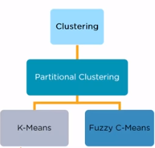
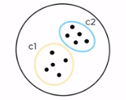
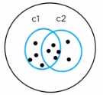


Partitional clustering

Slide 7
K means clustering
Exploratory data analysis technique
Implements non hierarchical method of grouping objects together
Determines the centroid using Euclidean method for distance calculation
Groups objects based on minimum distance

Slide 8

Applications

Slide 9

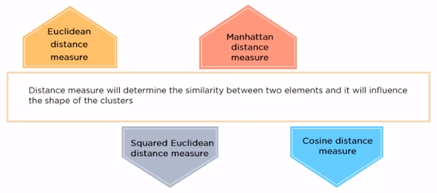



Distance measures

Slide 10
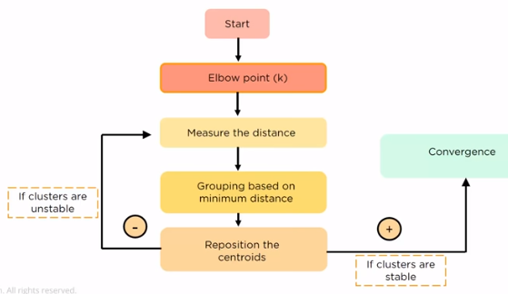
Working of k-means clustering

Slide 11
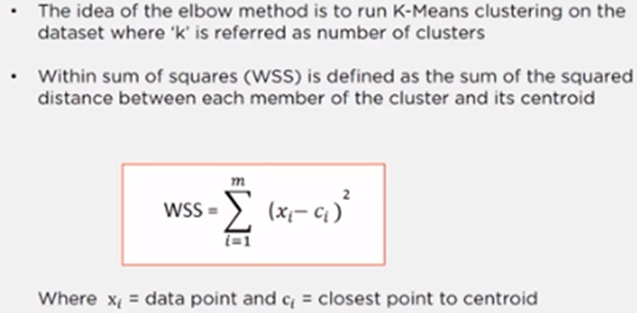
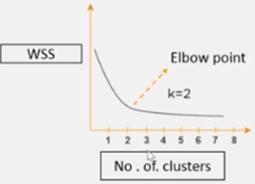
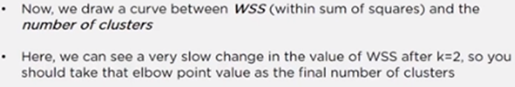
Elbow method

Slide 12
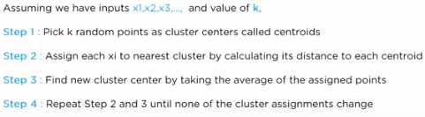
k-means clustering steps

Slide 13
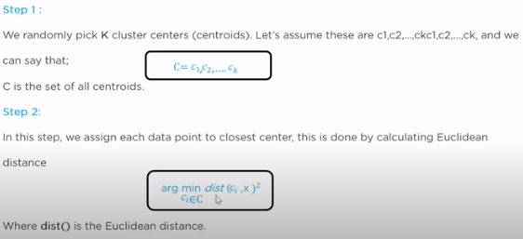
k-means clustering steps in detail

Slide 14
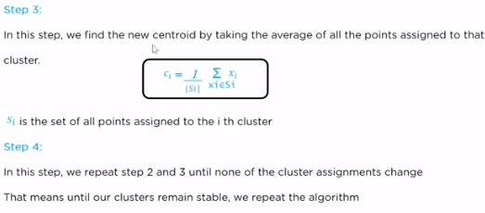
k-means clustering steps in detail

Slide 15
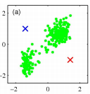
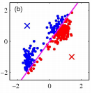
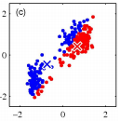
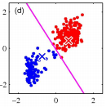
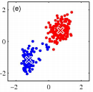
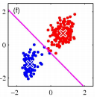
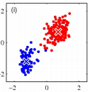
K-means clustering example

Slide 16
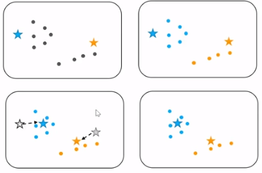
K-means clustering example

Slide 17
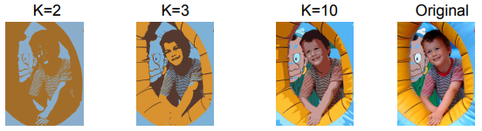
Example: K-Means for Segmentation

Slide 18
properties
• Guaranteed to converge in a finite number of iterations
• Running time per iteration:
1. Assign data points to closest cluster center
O(KN) time
2. Change the cluster center to the average of its assigned points
O(N)

Slide 19
Numerical Example 1
Cluster the dataset = {2,3,4,10,11,12, 20, 25,30} using k-means algorithm. We need to group into two clusters. Assume the initial centroids as 2 and 12.
 | Centroid1 = 2 | Centroid2 = 12
Iteration 1 | {2,3,4} | {10,11,12,20,25,30)
 | Centroid1 = 3 | Centroid2 = 18
Iteration 2 | {2,3,4,10} | {11,12,20,25,30}
 | Centroid1 = 4.75~5 | Centroid2 = 19.6~20
Iteration 3 | {2,3,4,10,11,12} | {20,25,30}
 | Centroid1 = 7 | Centroid2 = 25
Iteration 4 | {2,3,4,10,11,12} | {20,25,30}
 | Centroid1 = 7 | Centroid2 = 25
Iteration 5 | {2,3,4,10,11,12} | {20,25,30}

Slide 20


Numerical Example 2

Slide 21
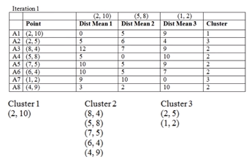
Numerical Example 2 - solution

Slide 22
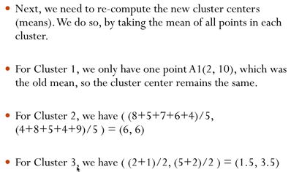
Numerical Example 2 - solution

Slide 23
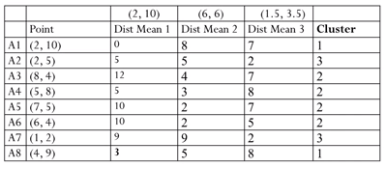
Numerical Example 2 - solution

Slide 24
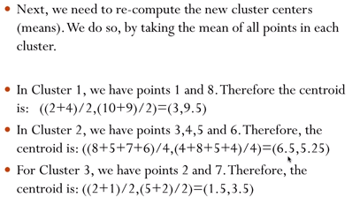
Numerical Example 2 - solution

Slide 25
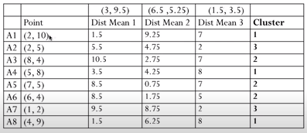
Numerical Example 2 - solution

Slide 26
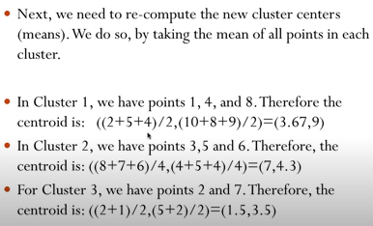
Numerical Example 2 - solution

Slide 27
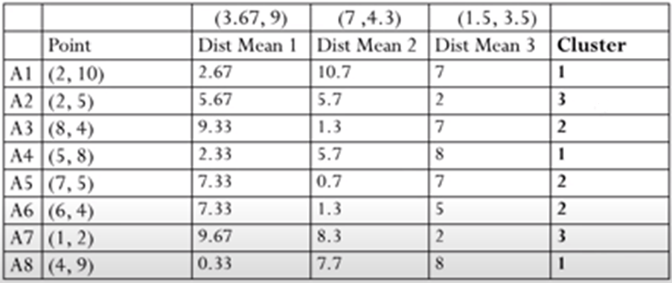
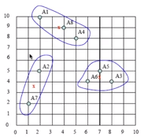
Numerical Example 2 - solution

Slide 28
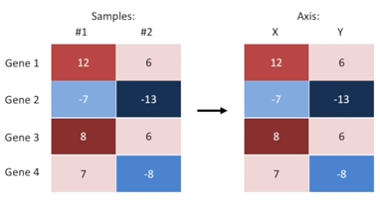
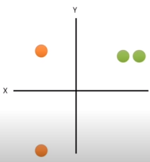
Heat map example

Slide 29
Advantages and disadvantages
Simple to understand Fast to cluster Widely available Easy to implement Always yields a result | We need to pick ‘K’ Sensitive to initialization Sensitive to outliers Produces spherical solutions Standardization required

Slide 30
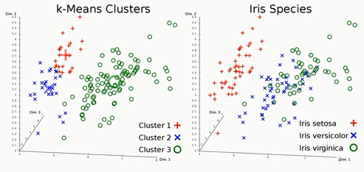
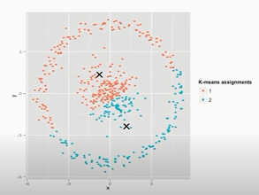
Where not to use k-means clustering
Will not tell how good the clusters are

Slide 31
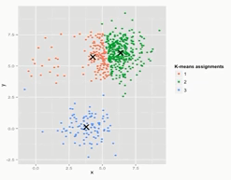
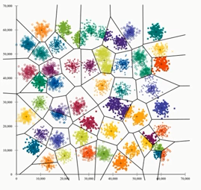
Where not to use k-means clustering
more weight to larger cluster
Ending in local minima

